Slide 1
Synchronous Job Submission Workflow
Start
Make API call for list of models
Parse response to find if any job is running
Parse response and prepare a list of ONLINE model names
No
Yes
Job running?
Make submit job API call for the model from the list of models
Pause for some time(1 mnt)
Make API call for list of jobs
Job for all models submitted?
No
Yes
End

Slide 2
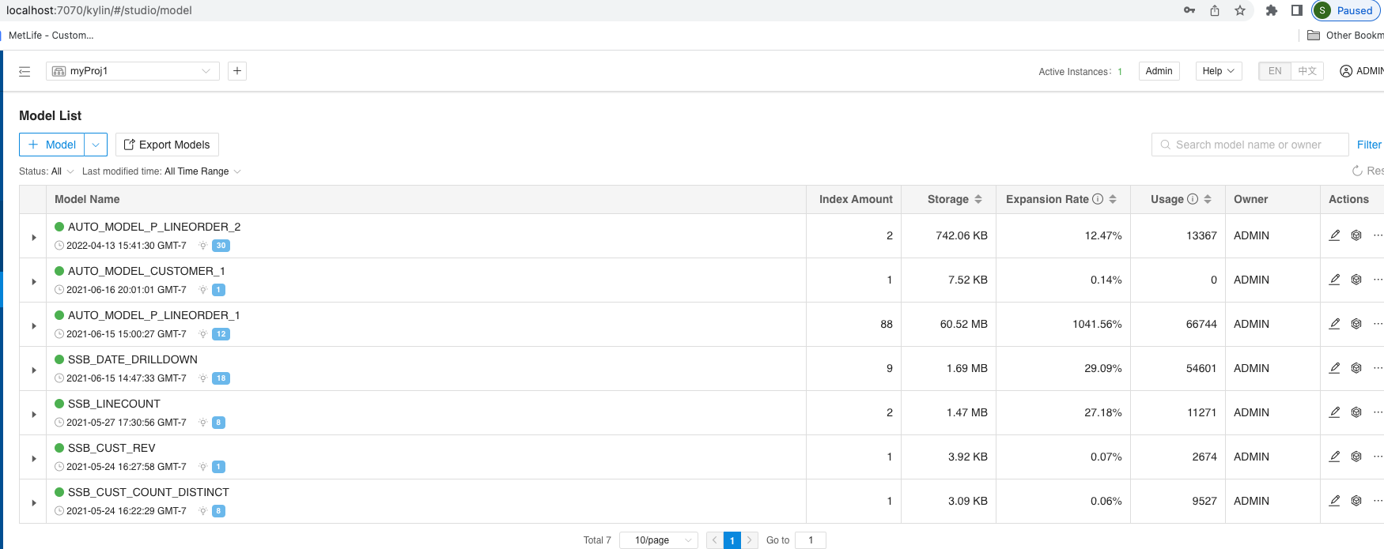
List of models in the project

Slide 3
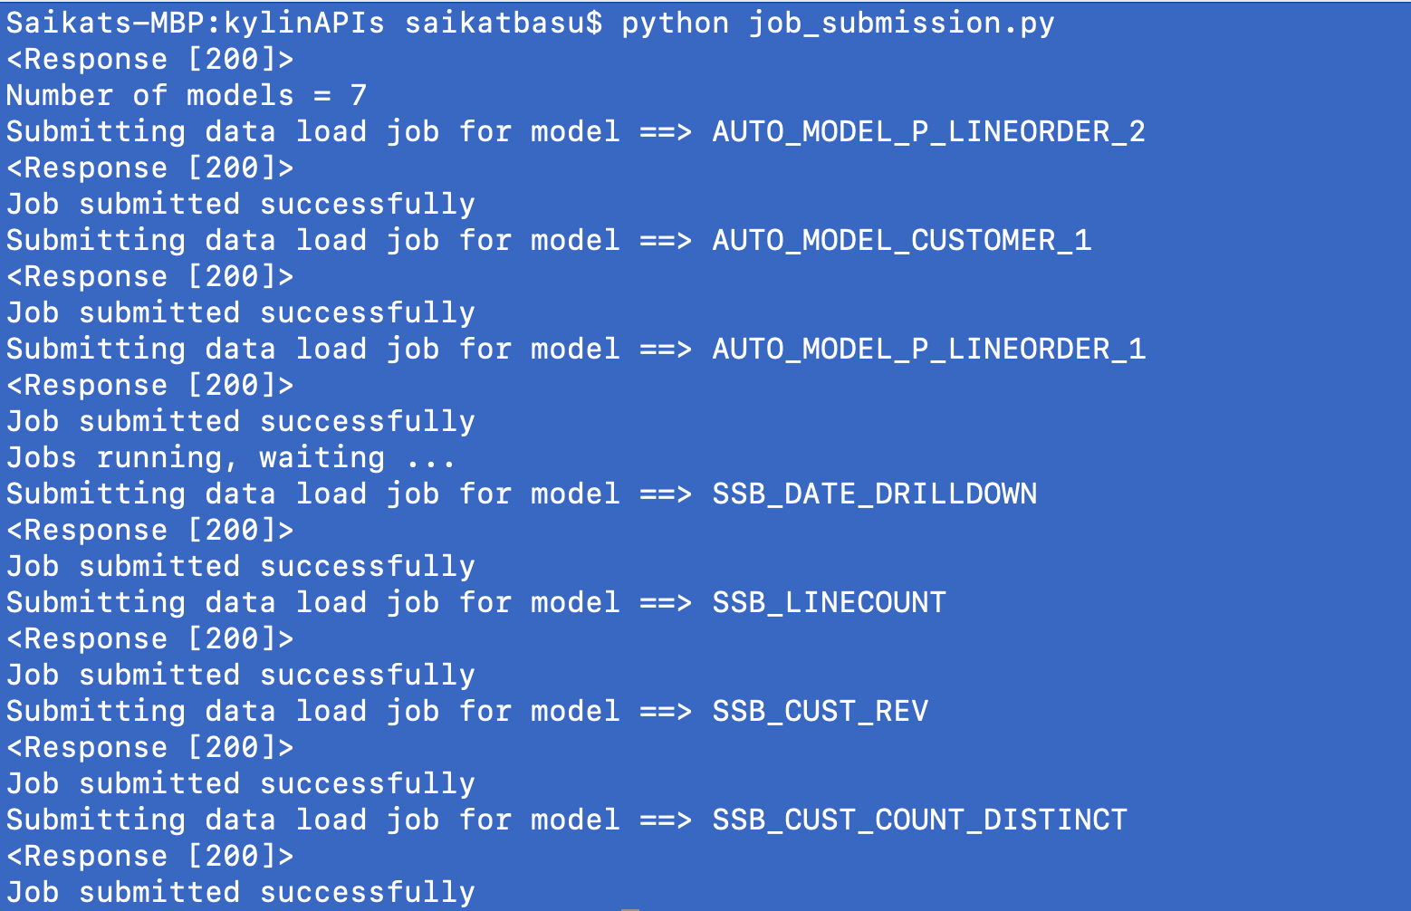
Program output for synchronous job submission

Slide 4
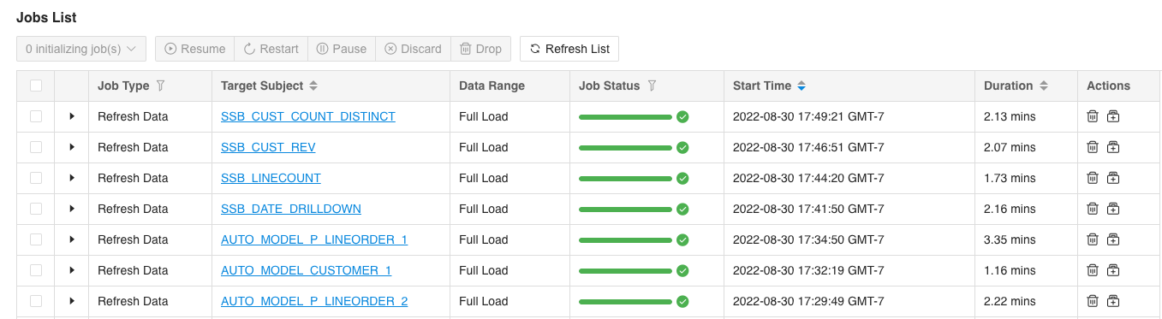
Job submission UI showing submission of 1 job at a time
+
+

